Slide 1
PERSONAL PROTECTIVE EQUIPMENT FOR
ELECTRICAL HAZARDS

Slide 2

Company Overview
VB Engineering is an Indian based company with its operations in India and Rwanda (East Africa).
Worlds second company providing integration of GIS and Engineering tools.
Pioneer in mobile application development.
Expert in Supplying GPS based products for various domains.
GPS tracking solutions platform (www.vainatheya.com).

Slide 3
Values & Vision
Values
Vision
Customer first
Quality
Professional ethics
Dignity of the individual
Good corporate citizenship
To be the most creative solution provider for the mobile apps
Anticipating and enabling change
Admired for technology, agility, innovation, business models and the quality of its talent

Slide 4

Company Highlights
Successfully completed the project funded by world bank in Africa.
First company in the world to automate the system study(arcflash, Earthing etc.,) process using latest technology.
The Unique and the first solution provider for GIS and electrical system integration.
Deployed more than 100 mobile applications for clients.
Introduced the revolutionary way of work in GIS using android and cloud technology.
Integrated safety with technology for Industries and institutions.
Placed more than 100 Consultants in various parts of globe for different domains.

Slide 5
Our Portfolio
VB Engineering
IT
Engineering
HR
GPS

Slide 6
Engineering
Industrial Electrification
Arcflash hazard analysis
Energy audits
Distribution Planning
Load flow and feeder separation
Meter data and system integration
Transmission Planning
Power evacuation studies
System studies
Earthing design

Slide 7
What is Arcflash Hazard?

Slide 8
An arc flash is a type of electrical explosion that results from a low impedance connection to ground or another voltage.
Arc occurs because of two reasons 1. Bolted Short Circuit 2. Arcing Short Circuit
Bolted Short Circuit
Arcing Short Circuit
A
B
A
B

Slide 9
Consequences of Arcing Short Circuit
Molten Metal
Extreme Heat 20,000 °C
( 5 times temp. of sun )
Pressure Waves
Sound Waves
Shrapnel
Copper Vapor:
Solid to Vapor
Expands by
67,000 times
Hot Air-Rapid Expansion
Intense Light ( More than 2000
times that of normal office light )

Slide 10
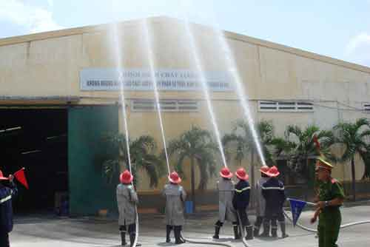
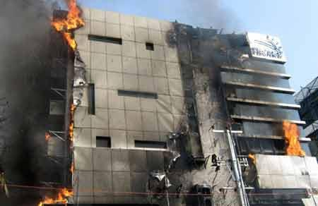
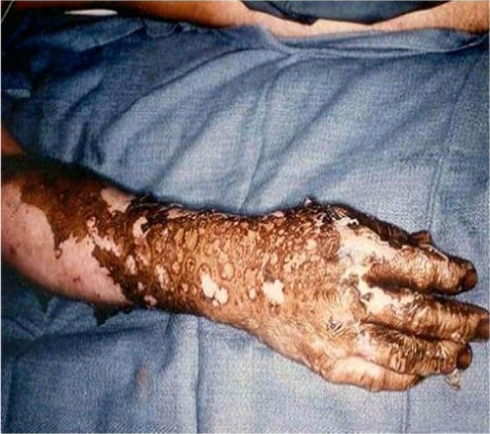
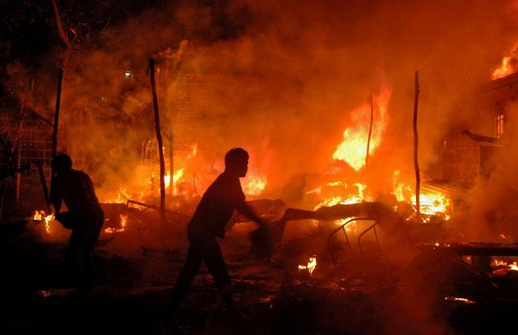
Impact of Electric Short Circuits
Serious Injuries & Medical Costs
Fractures, serious burns or even death.
Equipment damage & Repair Cost
Switchgear replacement
Other gear in close proximity
Production Loss
Considerable costs due to Lost
Production and delayed deliveries
OSHA Fines

Slide 11
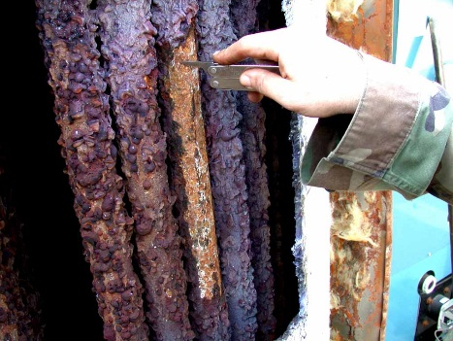
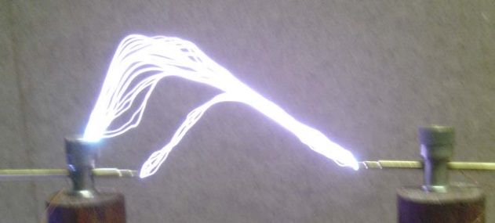
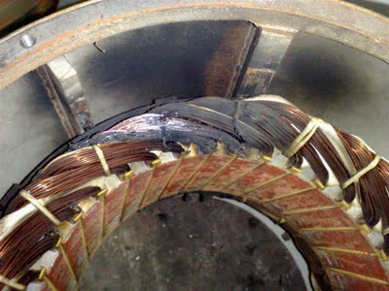
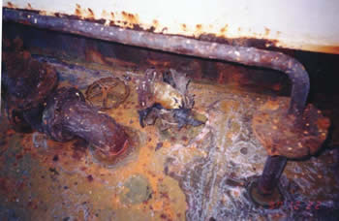
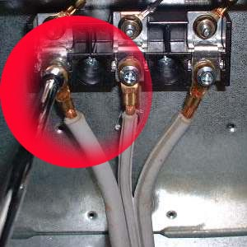
Causes of Electric Arc
Loose connections
Insulation failure
Poorly maintained equipment
Voltage transients
Unsuccessful Short Circuit Interruption
Dust and impurities
Corrosion
Condensation
Spark discharge
Overvoltage across narrow gaps
Improper work procedures

Slide 12
How VB Engineering will help you?
Examining and analyzing the existing plant/facility condition.
Identifying the most dangerous areas/zones in the plant.
Performing different electrical simulations (equipment evaluation, short circuit, protective device coordination, arcflash analysis) on the existing and proposed plant.
Recommending the remedies, settings and PPE for the plant.
Training and equipping all the employees with the PPE application.
Comparative study of existing plant condition and proposed.

Slide 13
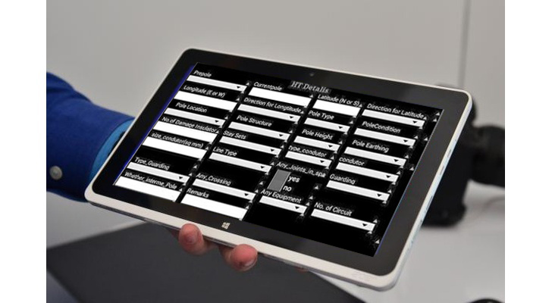
Our Working Style
Collect system and installation data using TopoBridge tablet to ensure no data is missed and time is saved.
Determine system modes of operation.
Determine bolted fault current.
Calculate arcing fault current.
Find protective device characteristics
and arc duration.
Calculate incident energy and flash protection
boundary.
Determine PPE (risk hazard) category.
Customize PPE application for your facility and employees.
Install the PPE app in all your employees mobiles and train them on the usage of the application.

Slide 14
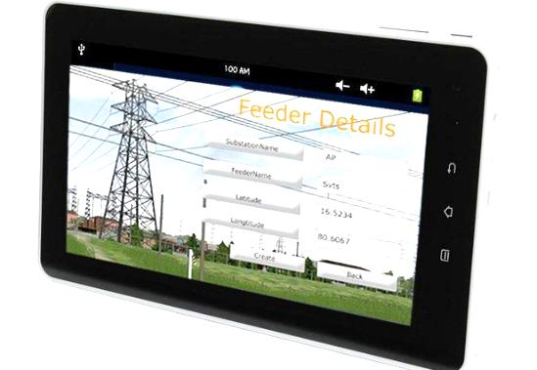


Data Collection
We use “TopoBridge” tablet to collect all the installation
data of plant.
How it works:
Collect the data using tablet.
Export the data to back office
from any where in the globe.
Import data to analysis software.
Data validation
Collect the missing data.

Slide 15
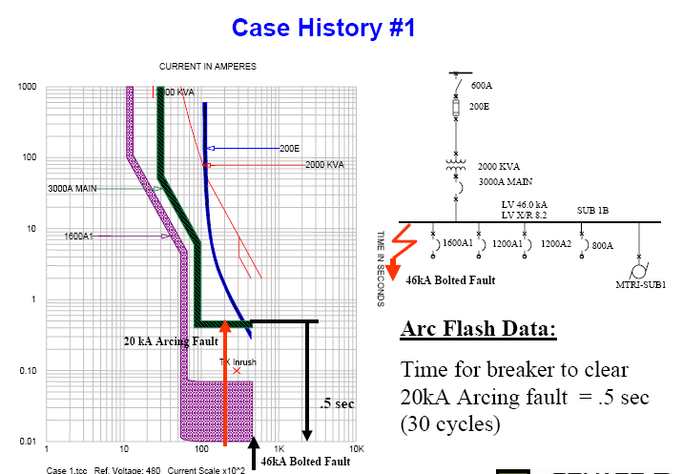
Design and Analysis
Experts will do the following simulation and analysis.
    Equipment Evaluation
    Short Circuit Studies
    Protective Device coordination
    Arcflash Analysis.
The existing condition of the plant is thoroughly studied and changes and remedies will be recommended where ever necessary.
Warning labels and work permits will be generated for the facility.
PPE will be suggested depending on the incident energy levels.
Comparative study for the existing plant and proposed will be furnished.

Slide 16
Arcing Fault Current
For bus voltage < 1 kV and 700A ≤ I_{B} ≤ 106kA
log (I_{A}) = K + 0.662 log (I_{B}) + 0.0966 V + 0.000526 G +
0.5588 V log (I_{B}) – 0.00304 G log (I_{B})
where
log log10
I_{A} arcing fault current
K –0.153 for open configuration and
–0.097 for box configuration
I_{B} bolted fault current – 3phase sym rms kA at the bus
V bus voltage in kV
G bus bar gap between conductors in mm
For bus voltage >= 1 kV and 700A ≤ I_{B} ≤ 106kA
log (I_{A}) =0.00402 + 0.983 log (I_{B})

Slide 17
Incident Energy
Energy per unit of area received on a surface located a specific distance away from the electric arc, both radiant and convective, in Units of cal/cm².

Slide 18
Incident Energy
log (En) = K1 + K2 + 1.081 log (Ia) + 0.0011 G
En Incident energy (J/cm²) normalized for 0.2s arcing duration and 610mm working distance
K1 –0.792 for open configuration
–0.555 for box configuration (switchgear, panel)
K2 0 for ungrounded and high resistance grounded systems
-0.113 for grounded systems
Ia Arcing fault current
G Gap between bus bar conductors in mm
solve En = 10 ^{log En}

Slide 19
Incident Energy
Incident Energy convert from normalized:
E = 4.184 C_{f} En (t/0.2) (610^{X} / D^{X})
E incident energy (J/cm²)
C_{f} 1.0 for voltage above 1 kV and
1.5 for voltage at or below 1 kV
t arcing duration in seconds
D working distance
x distance exponent
x Equipment Type kV
1.473 Switchgear <= 1
1.641 Panel <= 1
0.973 Switchgear > 1
2 Cable, Open Air

Slide 20
Flash Boundary
D_{B} arc flash boundary (mm)
D_{B} = [ 4.184 C_{f} En (t/0.2) (610^{X} / E_{B}) ]^{1/X}
where
E_{B} incident energy set 5.0 (J/cm²)
C_{f} 1.0 for voltage above 1 kV and
1.5 for voltage at or below 1 kV
t arcing duration in seconds
x distance exponent
x Equipment Type kV
1.473 Switchgear <= 1
1.641 Panel <= 1
0.973 Switchgear > 1
2 all others

Slide 21
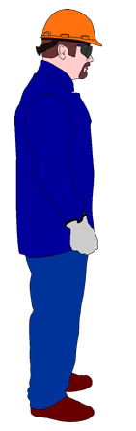
Flash Protection Boundary (FPB)
FPB dependent on fault level and time duration.
Warning label provides boundary information
Flash Boundary – 4 ft. or calculated
Limited
Restricted
Prohibited

Slide 22
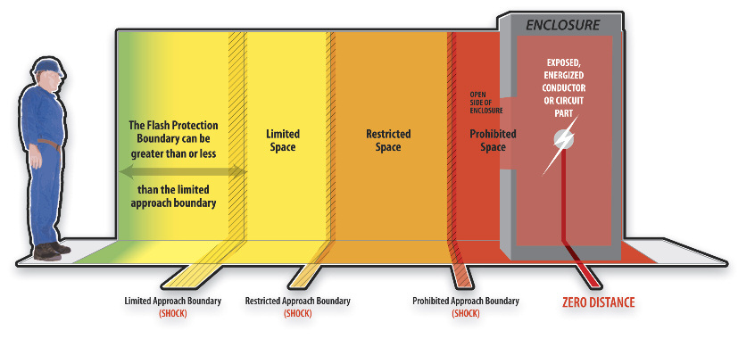
Prohibited Shock Boundary: Qualified Persons Only. PPE as
if direct contact with live part
Restricted Shock Boundary: Qualified Persons Only
Limited Shock Boundary: Qualified or Unqualified Persons*
* Only if accompanied by Qualified Person
Note: shock boundaries dependent on system voltage level

Slide 23
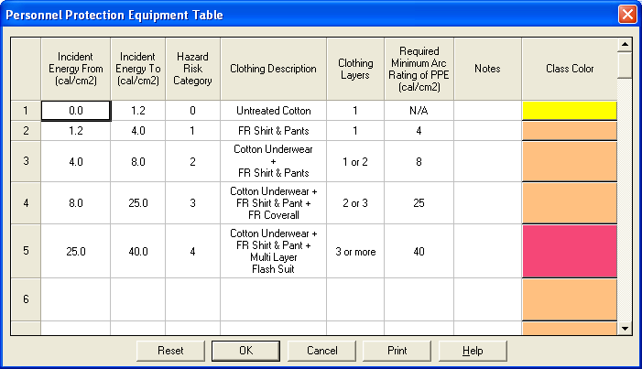
Appropriate PPE

Slide 24

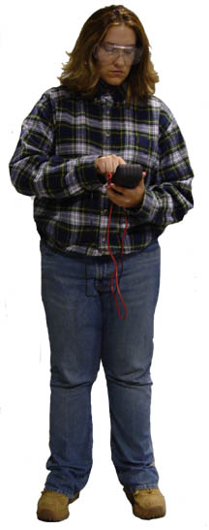
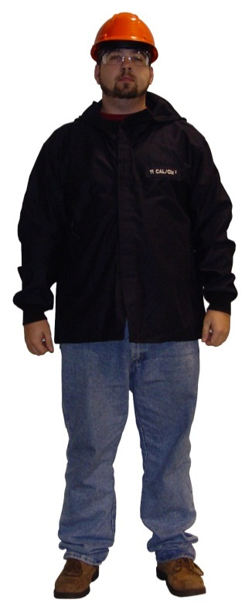
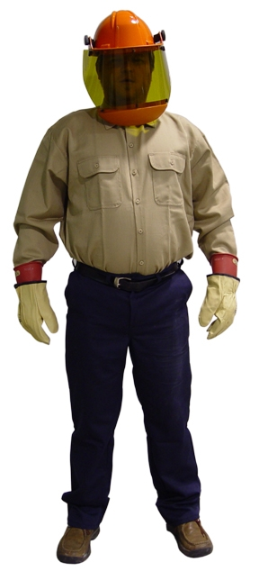
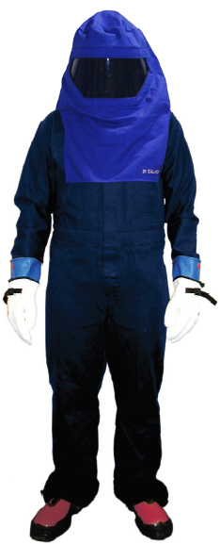
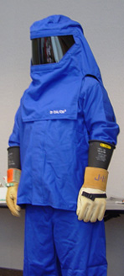
Category 4
Cotton Underwear
Short Sleeved “T” Shirt (Natural Fiber)
FR Long Sleeved shirt & Long Pants
FR Coverall ( Over the above)
Arc Flash Suit Hood
Arc Flash Suit Jacket (multi-layer )
Arc Flash Suit Pants (multi-layer )
Hard Hat
Safety Glasses or Goggles
Hearing Protection
Leather Gloves & Shoes as needed
Category 2
Cotton Underwear
Short Sleeved “T” Shirt (Natural Fiber)
FR Long Sleeved shirt & long Pants
or FR Coverall instead
Arc Rated Wrap around Face Shield
Hard Hat
Safety Glasses or Goggles
Hearing Protection
Leather Gloves & Shoes as needed
Category 3
Cotton Underwear
Short Sleeved “T” Shirt (Natural Fiber)
FR Long Sleeved shirt & Long Pants
FR Coverall ( Over the above)
Arc Flash Suit Hood
Hard Hat
Safety Glasses or Goggles
Hearing Protection
Leather Gloves & Shoes as needed
PPE Category Level
Category 1
Cotton Underwear
FR Long Sleeved shirt & long Pants or FR Coverall instead
Hard Hat
Safety Glasses or Goggles
Leather Gloves & Shoes as needed
Category O
Cotton Underwear
Long Sleeved shirt (Natural Fiber)
Long Pants (Natural Fiber)
Safety Glasses or Goggles
Hazard Risk Category 0
Hazard Risk Category 1
Hazard Risk Category 4
Hazard Risk Category 2
Hazard Risk Category 3

Slide 25
Constant Energy lines ( C – Lines )
Constant energy with respect to Time & Current

Slide 26
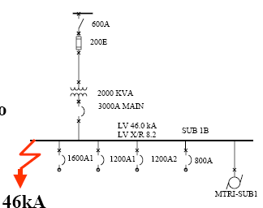
Arc Flash Calculation - Case Study 1
46kA,3Phase bolted fault Current on Station bus
Questions:
1] What is Arcing Fault ?
2] How long does it take for
main breaker or primary
fuse to clear ?
3] What is incident Energy ?
4] What is proper PPE?

Slide 27
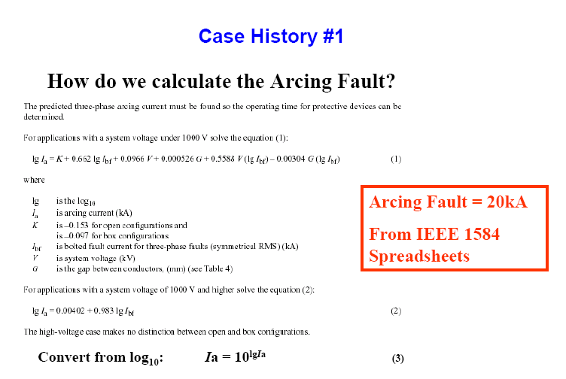

Slide 32
Arcing Fault Clear Time
CURRENT IN AMPERES
1000
Min
Max
A4BQ Fuse
A4BQ Fuse
100
Trip Time for Low Arcing Fault
10
TIME IN SECONDS
1
0.10
0.01
0.5
1
10
100
1K
10K
tcc3.tcc Ref. Voltage: 480 Current Scale x10^0

Slide 33
Arc Flash Incident
480 Volt System
22,600 Amp Symmetrical Fault
Motor Controller Enclosure
6-Cycle Arcing Fault (0.1 sec)

Slide 34
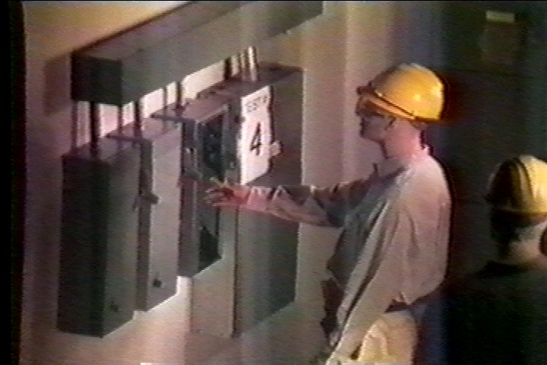
Copyright IEEE
Used by Permission

Slide 35

First Cycle
Copyright IEEE
Used by Permission

Slide 36
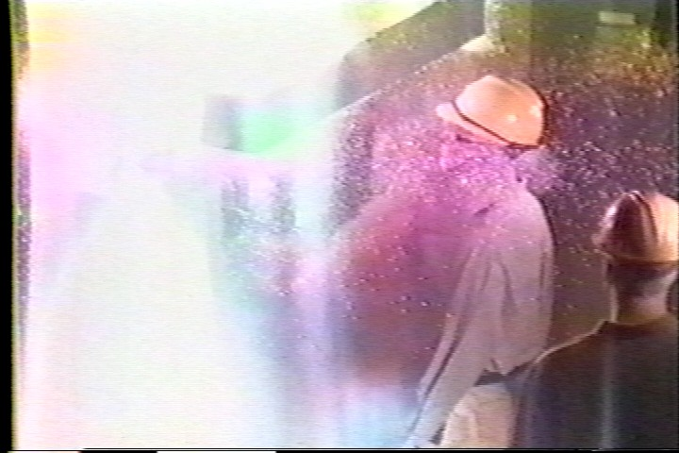
Second Cycle
Copyright IEEE
Used by Permission

Slide 37
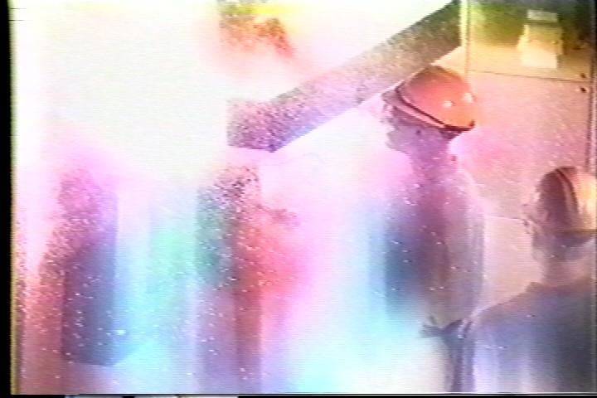
Third Cycle
Copyright IEEE
Used by Permission

Slide 38
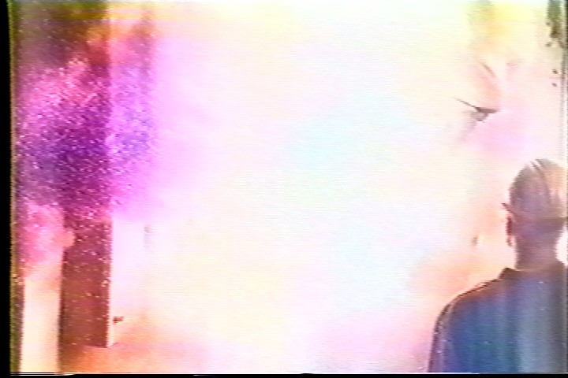
Fourth Cycle
Copyright IEEE
Used by Permission

Slide 39
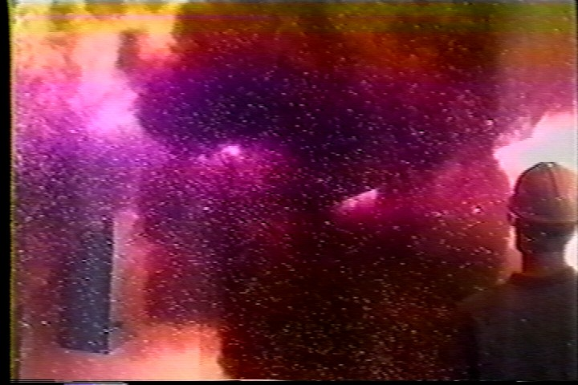
Fifth Cycle
Copyright IEEE
Used by Permission

Slide 40

Sixth Cycle
Copyright IEEE
Used by Permission

Slide 41

Solutions that Reduce Arc Flash Injuries and Damage
Faster Clearing Time
Reduce Available Fault Current
Label Equipment
Train Personnel
Use PPE
Minimize Risk with Good Safety Practices
Move People Further Away
Redirect Blast Energy
Prevent Fault

Slide 42

Report Structure
Executive Summary
Input Data
Assumptions
Existing Analysis
  Equipment Evaluation
  Short Circuit Study
  TCC Curves
  Arc Flash
Proposed Analysis
  Equipment Evaluation
  Short Circuit Study
  TCC Curves
  Arc Flash
Recommendations
Single Line Diagram
Arc Flash Labels
Work Permits
References
Check List

Slide 43
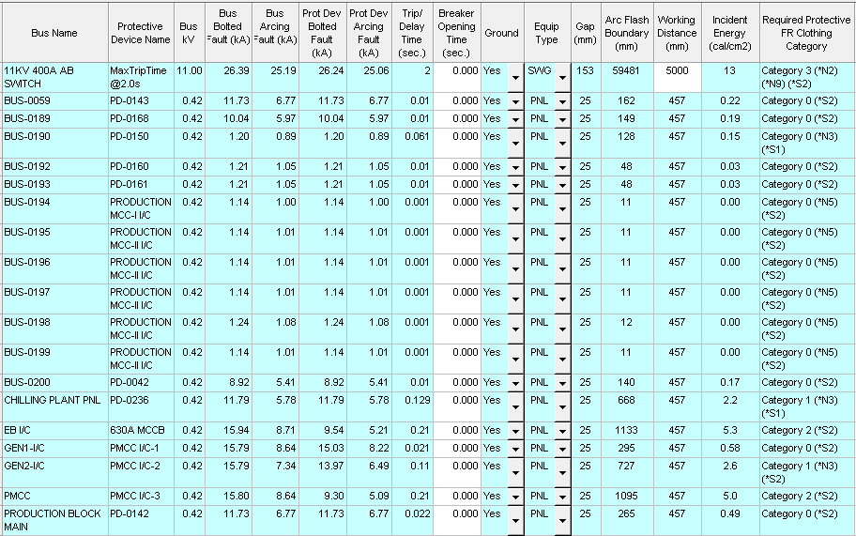
Generated Reports

Slide 44
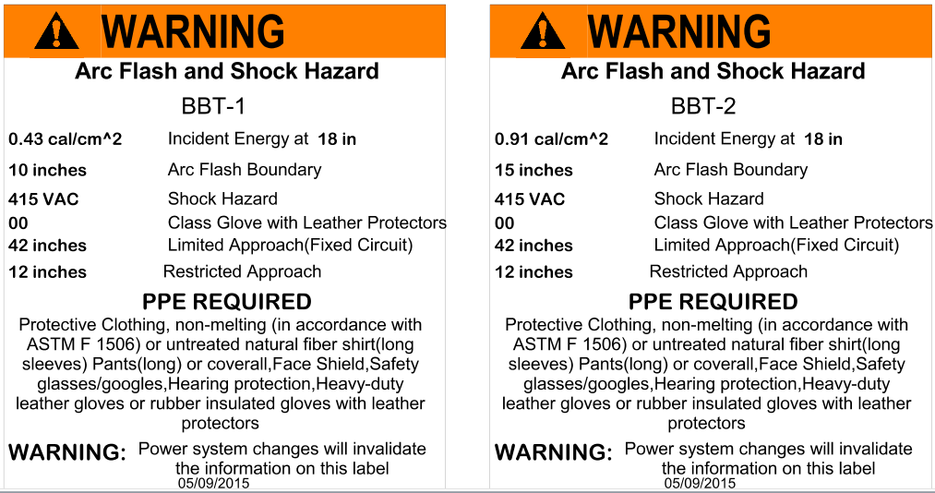
Labels

Slide 45




Standards we follow
NFPA 70E-2012
OSHA 1910
IEEE 1584
NEC 2002

Slide 46
PLANT DATA
COLLECTED
Utility Power Supply
Transformer
Cables
Protective Devices
Loads
Motors

Slide 47
Utility Power Supply
Utility Name: TSSPDCL
Supply voltage: 33000volts

Slide 48
Transformer
Type - Oil type
Rating - 2.5MVA(2)
% Z - 7.44
No of Transformers - 02

Slide 49
Cables
Type of cable -- Armored
Material -- Copper & Aluminum
Size of the Cable -- 6,10,16,35,95,185,400mm²...
Size of the Core -- 3,3.5,4 core

Slide 50
Protective Devices
Manufacturer -- ABB, GEC, Schneider, L&T…
Type
  Circuit Breakers --MVS10N,NT10H,NSX100N,T3S…
  Fuses --TSL,HN,HRC
Ratings -- 32A,63A,125A,250A,400A,
630A,800A,1250A,2000A,4000A .

Slide 51
Loads
Base voltage
Load in KW
Motors
Rating
Base voltage
Number of Poles
Status

Slide 52
Modes of Operation
The Possible basic modes of operation for the plant are as
  Scenario-1 : Running the Plant by using Utility
      and Generators

Slide 53
Assumptions
Utility Fault Level as 36KA.
All cables are considered from SKM library.
Cable impedances are taken as default values.
System voltage is modeled at 100% nominal.
Transformer X/R ratio as 6.5
For above 75HP motors transient and positive and negative sequence reactance are assumed.
Impedance values of transformers are assumed

Slide 54
Summary

Slide 55
Recommendations
Personal protective Equipment:
As per the calculated Incident energy at various locations in Sandvik Asia Industry various categories of Personal protective equipment's (PPE) are suggested as per NFPA – 70E standards. The operator shall ensure appropriate PPE while working on the live electrical panels.
Marking of Flash protection Boundary :
Arc Flash Protection Boundaries needs to be marked near panels with proper distances. These boundaries include, Limited Approach, Restricted Approach & Prohibited Approach. The operating person must have knowledge of these boundaries.
Arc Flash Training to operating personal:
Training must provide people the knowledge and understanding of the existence, nature, causes and methods to prevent electrical hazards. The training should also include the selection and use of appropriate PPE.
Revise Arc Flash Study periodically:
Revise the Arc Flash Study periodically with calculation of incident Energy & flash protection boundary. These calculations needs to be revised with modification in System arrangement & changes in protective devices.

Slide 56
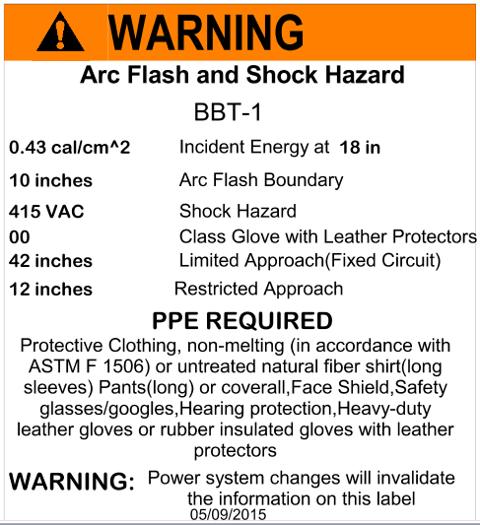
Sample Label

Slide 57

Training
Training will be given on the following topics .
Reading and understanding the report.
Understanding the standards and usage of the report.
Execution of the recommendations.
Reading and understanding the importance of the PPE and warning labels.
Usage of the PPE mobile app.
Following the basic electrical safety.

Slide 58

Deliverables
Existing facility analysis report
Proposed facility analysis report
Comparative analysis.
Warning labels
List of PPE
Customized work permits.
SLD
PPE mobile application for all the employees.
Training.

Slide 59

Wear Personal Protective Equipment (PPE)

Slide 60

Minimize Risk with Good Safety Practices
Bad – Exposed Back of Neck
Good – All Body Protected

Slide 61
Move People Further Away
Remain physically outside the flash protection boundary.
Therefore NO ARC FLASH HAZARD protection required!

Slide 62
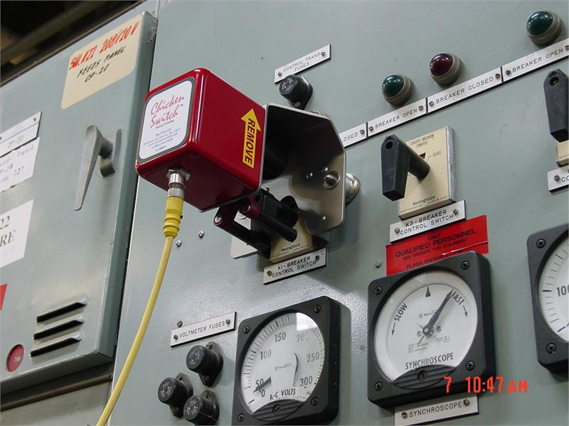
Remote Switching: Chicken Switch
Without
With

Slide 63
Redirect Fault Energy
5/15 kV Arc Construction

Slide 64
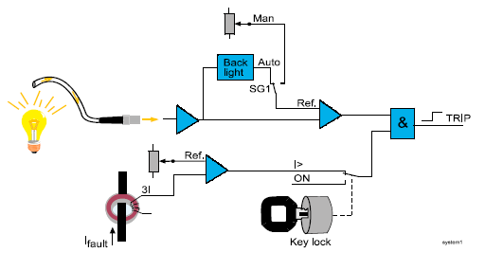
Arc Detection Relay Block Diagram

Slide 65
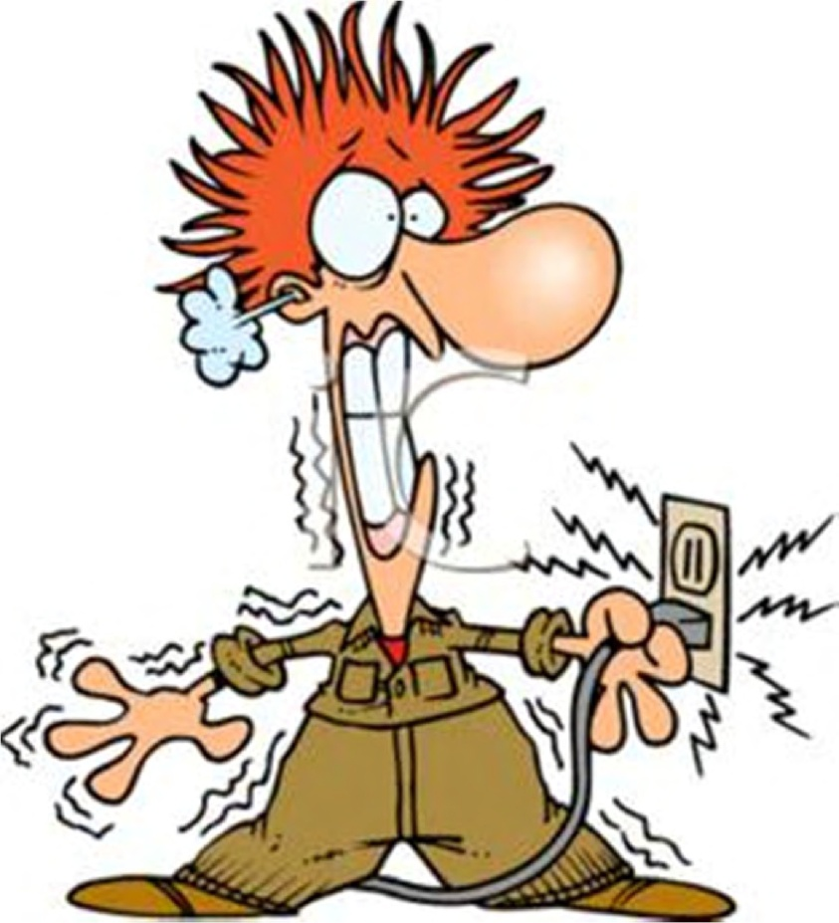
Do you know?
From 2003 to 2007, ESFI found that 28,401 workers died on the job. Of them, workers contact with electric current were responsible for 1,213 fatal workplace accidents during this period.
Additionally, 13,150 workers were so severely injured from these electrical contacts.
Every year more than 1million people are loosing their life due to electrical accidents.
Spending less than 1% of your property value for proper designing and safety will save your life and property at a time.

Slide 66
What statistics say
In a span of just one month (i.e. Jan 2013) list of major electrical mishaps came into lime light in our country.
For an year approximately more than 500 major
Electrical fire accidents are taking place.

Slide 67
Sector Wise Electrical Accidents

Slide 68
What is happening every year?!

Slide 69
Yearly Accident Statistics
Sl. No. | LOCATION | NO. OF ACCIDENTS
 |  | 1999 - 2000 | 2000 - 2001 | 2001 - 2002 | 2002 - 2003 | 2003 - 2004 | 2006 - 2007 | 2007 - 2008 | 2008 - 2009 | 2009 - 2010 | Total
1 | Generating Station | 0 | 3 | 0 | 0 | 2 | 0 | 5 | 1 | 2 | 13
2 | T & D lines - 11KV & above | 129 | 151 | 139 | 69 | 142 | 111 | 144 | 143 | 163 | 1191
3 | T & D lines - below 11KV | 97 | 103 | 213 | 88 | 158 | 189 | 269 | 261 | 222 | 1600
4 | Industrial Installations - Govt./semi Govt. | 13 | 16 | 8 | 43 | 0 | 1 | 18 | 1 | 17 | 117
5 | Industrial Installations – Private | 7 | 5 | 9 | 105 | 21 | 1 | 2 | 9 | 16 | 175
6 | Other Installations - Govt./ Semi Govt. | 17 | 27 | 6 | 1 | 7 | 4 | 0 | 2 | 1 | 65
7 | Other Installations –Private | 54 | 37 | 58 | 39 | 68 | 43 | 0 | 0 | 25 | 324
 | TOTAL | 317 | 342 | 433 | 345 | 398 | 349 | 438 | 417 | 446 | 3485

Slide 70
Causes of Accidents in Industries
This graph shows that 65% of
the accidents occurring are due
to electrical short circuits

Slide 71
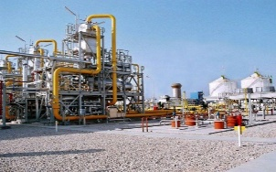
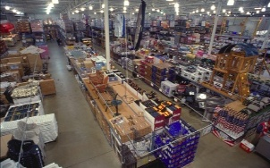
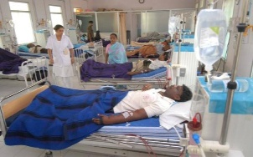
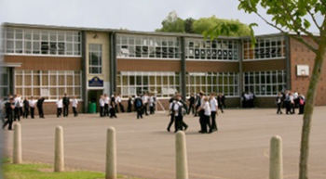

Highly sensible places for electrical mishaps
Industries
Shopping Malls
Hospitals
Schools
Public Places

Slide 72

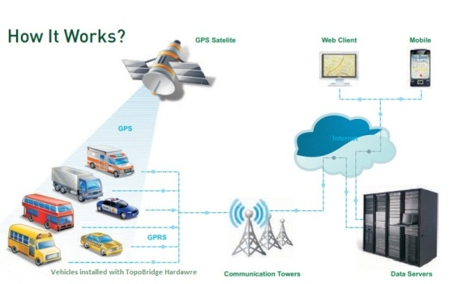
Products
Hardware
  Salasbury PPE
  TopoBridge tablet
  Vainatheya vehicle tracker
Software
  Industrial data collection app
  Plant maintenance app
  PPE app
  Family tracker
  Sales force tracker
  HRMS
  School bus tracking system
  School management system
  TopoBridge (GIS Application)

Slide 73
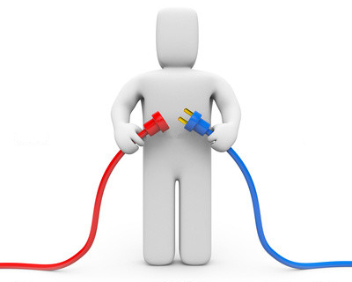
Why VB Engineering
Unique experience of multiple domains
Dedicated team for every project.
Always upgrade with technology.
Cost effective solutions as per requirement.
End to end services suiting your needs.
Customized development.
Quality deliverables.
Ethical relationships.
And finally “True value for your money”

Slide 74
What Clients Say About US
FMC: “Excellent and remarkable services”
Plant Manager
Tech labs: “Masters of engineering IT”
AVP Technical
Sofreco: “Committed to delivery and time”
Delivery Manager
And many more…

Slide 75













Client List

Slide 76

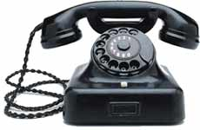
Contact Us:
:maruthi@vbengg.com
: 91-40-40064644

Slide 77
Conclusions
With the increased emphasis on safety in the workplace, companies are required to perform an Arc Flash Hazard analysis as per NFPA 70E and IEEE1584.
Selection of appropriate PPE, increasing the working distance and modifying the work methods is the simple way to reduce
arc flash hazards.
Effective way to reduce an Incident Energy in an existing
electric system is to review and modify over current
protection settings by –
A] Reducing available fault current
B] Reducing the Clearing time

Slide 78
References
IEEE Guide for Performing Arc-Flash Hazard Calculations, IEEE 1584-2002.
IEEE Recommended Practice for Protection and Coordination,
IEEE 242-2001 (IEEE Buff Book).
H.W. Tinsley III and M. Hodder, “A practical approach to arc flash hazard analysis and reduction” in Proc. IEEE IAS Pulp and Paper Ind. Com. 2004.
Robert A. Wilson, “Arc flash hazard Analysis and Mitigation” in Western Protective Relay Conference Spokane, 2004
J. C. Das, “Design Aspects industrial Distribution Systems to limit Arc Flash Hazard” IEEE Ind. Appl. Nov 2005.
NFPA 70-2002. National Electrical Code & Electrical Safety
Requirements for Employee Workplaces, NFPA 70E-2004.

Slide 79
Thank You

